Slide 1
Cultural Heritage Protection and Promotion in the EU FTAs
Alessandra Quarta
PhD Candidate - Cultural and Environmental Heritage
University of Bologna

Slide 2
Agenda
1
Trade/Culture dilemma
Cultural exception
2
UNESCO Convention 2005
3
Conclusion
Thematic Indicators for culture in the Agenda 2030
EU FTAs and culture

Slide 3
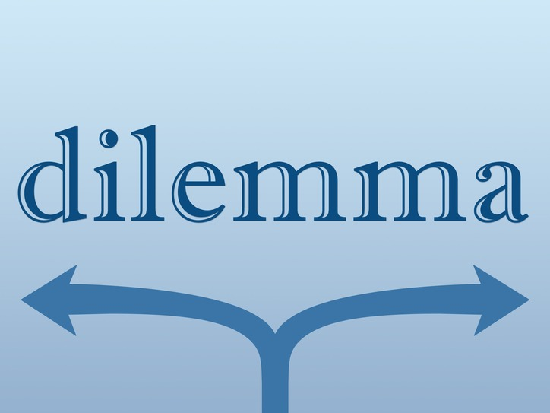
Trade
Culture
Notes:
Here you can see the set of indicators developed by the UNESCO for analising the impact of culture in the SDGs and in particular the dimension Environment & Resilience provides a framework for evaluate the role and contribution of culture to sustainable human settlements with particular attention to culture and natural heritage and the urban environment, echoing the 'planet' pillar of the SDG. The second dimension Prosperity & Livelihoods provides a framework for evaluate the contribution of culture in driving and enable more inclusive and sustainable economies, in line with the 'Prosperity' pillar of the SDGs, generating income and employment, as well as stimulating revenue through cultural goods, services and businesses. The third dimension Knowledge & Skills provides a framework for assessing the contribution of culture in building knowledge and skills including local knowledge and cultural diversity. It focuses specifically on the contribution of culture to the transmission of local cultural values, knowledge and skills. The last dimension Inclusion & Partecipation provides a framework for assessing the contribution of culture in building social cohesion, as well as in fostering inclusion and participation. It focuses on the abilities of people to access culture, the right of all people to participate in cultural life, and their freedom in cultural expression. These indicators are used to help experts in the field to assess with concrete data what is the actual approach of culture to sustainable development to be able to demonstrate what is said about the centrality of culture and its close connection with numerous current issues.
It is also thanks to the constant commitment of international organizations such as UNESCO and the EU itself that such important goals can be achieved, so we can only hope that the efforts of the EU and the individual member states in the field of culture will continue to keep up with the challenges that arise from time to time.

Slide 4
Convention on the Protection and Promotion of the Diversity of Cultural Expressions, UNESCO (2005)
Role of European Union
Cultural diversity
Guiding principles articles 2 paragraph 5 and 6
Articles 13, 16, 20
Cultural Cooperation Protocol (CARIFORUM, Korea, Central America)

Slide 5
PRE-LISBON TREATIES | POST-LISBON TREATIES
TRADE/CULTURE | DG Trade > DG Education and Culture
CULTURAL EXCEPTION | UNESCO Convention on the Protection and Promotion of the Diversity of Cultural Expressions (2005)
European Economic Community and the Swiss Confederation → 1973 Art.20 “The Agreement shall not preclude prohibitions or restrictions on imports, exports or goods in transit justified on grounds of […] the protection of national treasures of artistic, historic or archaeological value…” | CARIFORUM States and the European Community and its Member States → 2008 European Union and its Member States and the Republic of Korea → 2010 European Union and its Member States and Central America → 2012
European Communities and their Member States and the Kingdom of Morocco → 2000 Art.28:“This Agreement shall not preclude prohibitions or restrictions on imports, exports or goods in transit justified on grounds of […] the protection of national treasures of artistic, historic or archaeological value…” | Same wording: «Having ratified the UNESCO Convention on the Protection and Promotion of the Diversity of Cultural Expressions adopted in Paris on 20 October 2005» Audiovisual provisions → co-production Committee on Cultural Cooperation

Slide 7
Concluding Remarks
1
Trade/Culture dilemma
2
UNESCO Convention (2005)
3
EU’s traditional position in FTAs
4
Thematic Indicators for culture in the Agenda 2030
THANK YOU!

